Slide 1


Green Bonds Versus Conventional Bonds – Which Types Perform Better?
By: Swagat

Slide 2
Chapters
Chapter 1……………………………………………….............Introduction
Chapter 2…………………………………………………..........Socially Responsible Investing (SRI)
Chapter 3…………………………………………………………..Theoretical Framework
Chapter 4…………………………………………………………..Literature Review
Chapter 5…………………………………………………………..Data & Methodology
Chapter 6…………………………………………………………..Empirical Results
Chapter 7…………………………………………………………..Conclusion

Slide 3

Some history about bonds..
The earliest evidence is a stone tablet discovered in Nippur, in modern-day Iraq, which dates from 2,400 B.C. It records the payment of an amount of grain (the main trading currency at the time) with an assurance of a full reimbursement plus an excess (interest payment) by a certain date.

Slide 4

History continues
Modern corporate bonds began to be used when a formal banking system and corporate law was established in the Netherlands in the early 17th century. They were issued to finance the Dutch East India Company in 1623 and were the first of its kind to be issued to the general-public for sale and trading.

Slide 5
On this study we will know about..
Objective: Study examines green bond performance in secondary market vs. conventional bonds.
Method: Used matched pairs method on 37 bond couples from European institutions.
Findings: Average negative green bond premium of 0.93 bps due to high demand and investor preference.
Influencing Factors: Premium not significantly affected by bond rating, issue amount, or industry.
Significant Factors: Negative premium linked to remaining maturity of bond and ESG rating of issuer.
Implications: Findings are important for bond issuers, investors, and policymakers.

Slide 6
introduction
Chapter 1

Slide 7
Introduction
Global warming and climate change pose significant challenges, leading to climate disasters like rising sea levels and extreme weather events.
Climate change exacerbates global inequalities, impacting poorer populations disproportionately due to limited resources for risk prevention.
The Paris Agreement aims to limit global temperature increase to below 2°C above pre-industrial levels, requiring radical changes in energy, transport, construction, and water infrastructure.
IPCC recommends cutting emissions by 45% by 2030 and achieving net-zero emissions by 2050 to limit global temperature rise to 1.5°C.
Investments of around USD $6.9 trillion are needed for global infrastructure to meet the Paris Agreement's sustainable development goals, requiring private investments.

Slide 8
'Green finance' and green bonds are emerging as key tools for funding sustainable infrastructure projects.
Green bonds play an increasingly vital role in the financial market, contributing to climate change mitigation.
Studies show mixed results on the green bond premium, with some indicating a negative premium and others a positive one.
This thesis investigates the green bond premium using the latest data, focusing on European green bond issuers, and denominated in Euros.
The research question is: Is there a negative green bond premium for investors in the secondary market?

Slide 9
Hypothesis development

Slide 10
Hypothesis 1: There is a negative green bond premium in the secondary market.
Investors may pay a higher yield for green bonds compared to conventional bonds due to environmental support motivations (Roe, Teisl, Levy, & Russell, 2001).
Higher demand for green bonds than supply can lead to a pricing shift favoring green bonds (Preclaw & Bakshi, 2015).
The hypothesis suggests investors pay additional basis points for green bonds with similar characteristics and financial conditions as conventional bonds.
The hypothesis is based on the premise that investors value environmental support and prioritize green investments.
The study aims to test this hypothesis to understand the dynamics of green bond pricing in the financial market.

Slide 11
Hypothesis 2: The negative green bond premium is larger for lower-rated bonds.
Hypothesis 2 suggests that lower-rated bonds will have a larger negative green bond premium due to increased credit risk and volatility.
Studies by Ehlers and Packer (2017) and Preclaw and Bakshi (2015) indicate the negative green bond premium grows for riskier borrowers.
The study aims to investigate if this relationship holds true in the current green bond market.
The hypothesis examines the impact of credit risk on the green bond premium.
This hypothesis relates to the broader context of understanding the dynamics between credit risk, bond rating, and green bond pricing.

Slide 12
Hypothesis 3: The negative green bond premium varies across industries
Different industries issuing green bonds have unique characteristics affecting the negative green bond premium.
Hachenberg and Schiereck (2018) suggest government-related bonds typically trade tighter due to higher average ratings compared to corporations.
The study aims to examine the validity of Hachenberg and Schiereck's statement on bond ratings and green bond premiums.
The research explores how industry-specific characteristics influence the negative green bond premium.
Understanding industry differences can provide insights into the variability of green bond pricing across sectors.

Slide 13
Structure of the study
Chapter 2 introduces the background and key topics of the thesis.
Chapter 3 outlines the theoretical framework and bond valuation concepts. Also, Theoretical terminology and bond characteristics are discussed in this Chapter.
Chapter 4 presents the study's results and compares them with relevant studies.
Chapter 5 details the data sources and methodology for testing the hypotheses.
Chapter 6 reveals the study's findings, followed by a discussion and comparison with another green bond research.
Chapter 7 summarizes the thesis' key findings and contributions to the literature.

Slide 14
Socially Responsible Investing (sri)
Chapter 2

Slide 15
What is socially responsible investing (SRI)?
Socially Responsible Investing (SRI) is an investment strategy.
It aims for both financial returns and positive social or environmental impact.
SRI evaluates companies based on ethical, social, and environmental practices.
Investors in SRI support businesses that operate responsibly.
The goal is to contribute to societal well-being and environmental sustainability.
This chapter offers the background of the study, establishing an understanding of the various topics covered.
It introduces socially responsible investing, along with related concepts of corporate social responsibility (CSR) and environmental, social, and governance (ESG).

Slide 16
Chapter 2.1: progression of sri
Ethical use of money dates back to ancient religious texts like the Vedas, which criticize charging interest as usury.
Similar views on usury are found in Judaism, Christianity, Islam, and Buddhism (Renneboog, Ter Horst, & Zhang, 2008).
Early responsible money practices included wise use and restricting interest charges.
Muslims, guided by Sharia, avoid receiving 'riba' (interest) and investing in tobacco, gambling, or alcohol industries (Ayub & Pribadi, 2007).
In the 1920s, the Methodist Church practiced early Socially Responsible Investing (SRI), avoiding 'sin stocks' like alcohol, gambling, and tobacco (Renneboog et al., 2008).
The relationship between ethics and money gained momentum during the civil rights movement and anti-Vietnam War protests.
The Pax World Balanced Fund, founded in 1971, was one of the first SRI funds, excluding businesses related to militarism (Migliorelli & Dessertine, 2020).
Three major developments shaped the SRI movement: climate change concerns, understanding the impact of poor corporate governance, and discussions on institutional investor responsibility.

Slide 17
Continued..
Events like the Three Mile Island incident (1979), Chernobyl disaster (1986), and Exxon Valdez oil spill (1989) raised global awareness about corporate behavior's environmental impact.
The first SRI conference occurred in 1989 in response to growing environmental concerns (Migliorelli & Dessertine, 2020).
SRI evolved over time due to wars, company scandals, and societal issues like racism, inequality, and poor working conditions.
Today, SRI is a significant factor in finance, influenced by changing consumer behaviors and 'ethical consumerism'.
'Ethical consumerism' is when consumers choose ethically produced products based on personal values.
The tightening of environmental laws, such as ESG issue disclosures for firms, also favored SRI development (Renneboog et al., 2008).
CSR (Corporate Social Responsibility) and ESG (Environmental, Social, and Governance) are important concepts related to SRI, with individual chapters dedicated to each in the thesis.

Slide 18
2.2: Understanding Socially Responsible Investing and its Principles
Socially Responsible Investing (SRI) lacks a universally accepted definition, leading to debates on associated terminologies like ESG investing, CSR, ethical investing, and impact investing.
Sparkes (2001) differentiates SRI from ethical investing, arguing that the latter should not seek financial profit.
Despite variations, most academics use the term SRI similarly (Schueth, 2003; Yan, Ferraro, & Almandoz, 2019).
Sustainability, as defined by Asheim (1994), emphasizes managing resources for present and future generations' quality of life.
Sustainable development is promoted in businesses through Corporate Social Responsibility (CSR) and in investments through SRI.

Slide 19
SRI and CSR indicate that ethics has a role in business practices.
Business ethics is a debated topic without a universally accepted perspective (Brenkert, 2019).
Definitions of SRI may vary among investors and companies across different countries.
Socially responsible investing integrates personal and ethical concerns into investment decisions (Hamilton, Jo, & Statman, 1993).
Domini (2001) defines SRI as integrating personal or ethical concerns into investments to support human dignity and environmental sustainability.
Eurosif (2020) describes SRI as a long-term investment approach integrating ESG factors to benefit investors and influence corporate behavior.
Eurosif's definition emphasizes the importance of ESG factors in SRI.
SRI has evolved over time, shifting from a focus on specific actors to the overall investment process (Kinder, 2005).

Slide 20
The concept of a sustainable financial system is considered in this chapter.
In 2006, the United Nations introduced the Principles of Responsible Investment (PRI) at the New York Stock Exchange.
UNPRI is an investor initiative in partnership with UNEP and the UN Global Compact.
UNPRI aims to promote a more sustainable global financial system through six responsible investment principles.
These principles provide voluntary guidance on incorporating ESG issues into investment practices (PRI, 2020).
Signatories of PRI commit to implementing these principles in their investment decision-making processes.
The initiative underscores the importance of understanding sustainability implications for investors and integrating them into investment strategies.

Slide 21
PRI’s 6 principles which a signee agrees to adhere:
Principle 1: Incorporate ESG issues into investment analysis and decision-making processes.
Principle 2: Active management of investments and incorporate ESG issues into ownership policies and practices.
Principle 3: Seek appropriate disclosure on ESG issues by the entities in which they invest.
Principle 4: Promote the acceptance and implementation of the principles within the investment industry.
Principle 5: Work together to enhance the effectiveness of implementing the principles.
Principle 6: Reporting of activities and progress toward implementing the principles.

Slide 22
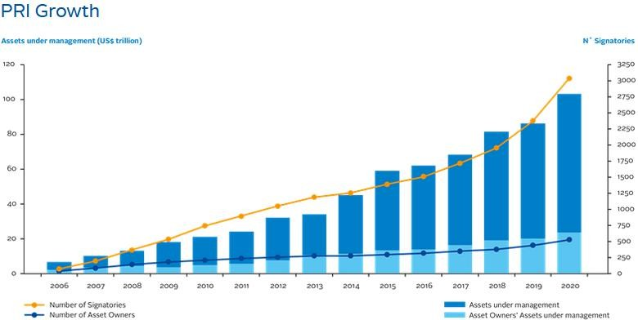
Y-o-y growth – pri (2011 – ’20)
Awareness of responsible investing has grown steadily over the years, with increasing demand for responsible investment solutions.
The Principles for Responsible Investment (PRI) has seen rapid growth in signatories since its launch in 2006, increasing from 63 to over 3,000.
The number of PRI signatories doubled in the last five years, indicating a strong trend towards responsible investing.
In 2020, PRI signatories managed assets exceeding USD $100 billion, highlighting the significant financial impact of responsible investment.
Figure 1: PRI signatory growth (PRI, 2020)

Slide 23
2.2.1: Goals for Socially Responsible Investing
In 1952, Harry Markowitz introduced modern portfolio theory, aiming to maximize expected returns for a given level of market risk.
Modern portfolio theory focuses solely on expected return and risk, unlike Socially Responsible Investment (SRI), which considers social, environmental, and ethical impacts (Sparkes, 2001).
Schueth (2003) identifies two types of SRI investors:
Feel-good' investors prioritize aligning investments with personal values and feeling good about their choices.
Investors interested in societal impact aim to positively influence society, such as improving quality of life.
Markowitz's theory has significantly influenced mainstream investment behaviors, emphasizing expected return and risk (Markowitz, 1952).

Slide 24
The literature on ethical investment offers three potential motivations for individuals to prioritize social responsibility in their investment decisions (Beal, Goyen, & Philips, 2005):
The possibility of gaining superior financial returns
Chance to gain non-wealth returns.
Chance to contribute to social improvements.
Schueth (2003) and Beal et al. (2005) only scratch the surface of the various motivations for SRI. Nonetheless, these studies offer valuable insights into the primary factors influencing ethical investment choices. While this thesis focuses on SRI's theoretical aspects, practical implementation through various investment strategies is not explored due to its limited relevance to the research questions.

Slide 25
2.2.2: Corporate Social Responsibility
SRI and CSR are growing in investor interest due to their close connection.
Companies with high CSR scores are favored by SRI investors.
More companies are investing to improve their CSR scores.
A company's CSR score is based on its ESG performance.
Agencies like Refinitiv, Bloomberg, and KLD offer CSR rankings to guide SRI decisions (Mullerat Balmaña, 2010).

Slide 26
Studies differ on whether improving CSR scores benefits companies financially.
Margolis & Walsh (2003) and Jeong et al. (2018) find improved financial performance linked to better CSR practices.
Some research suggests CSR investments may be wasteful and not improve performance (Harjoto & Laksmana, 2018).
Overall, a strong CSR profile tends to correlate with better financial performance and adds value to firms (Arx & Ziegler, 2008; Shank et al., 2005).
Adam Smith (1776) suggests companies engage in CSR out of self-interest.
Aviva's CEO, Mark Wilson, emphasizes enlightened self-interest as the driving force behind sustainable business practices (Green Finance Initiative, 2016, p. 9).

Slide 27
2.2.3: Environmental, Social and Governance
CSR evolved into ESG for better measurability and control metrics in corporate strategy (Skroupa & Sgambati, 2018).
ESG comprises environmental, social, and governance dimensions:
Environmental: Climate change, pollution, resource allocation.
Social: Employee rights, child labor, quality standards.
Governance: Corruption, transparency, gender ratios (Dorfleitner et al., 2015).
ESG enables investors to align investments with moral values (Auer & Schuhmacher, 2016).
‘Double-bottom analysis': Investors select companies with above-average ESG valuations (Schueth, 2003).
ESG ratings were introduced to simplify stakeholder evaluations of company reports.

Slide 28
ESG rating market has grown over 15 years, attracting major players and traditional financial data providers (Novethic, 2014).
ESG rating agencies are independent and not standardized, making comparisons challenging (Dorfleitner et al., 2015).
Leading ESG rating agencies include RobecoSAM and Sustainalytics (Novethic, 2014).
This research uses ESG ratings from RobecoSAM and Sustainalytics to study the impact on green bond issuers.
Sustainalytics' ESG risk rating assesses remaining unmanaged ESG risks and is industry-specific, based on a minimum of 70 indicators.

Slide 29
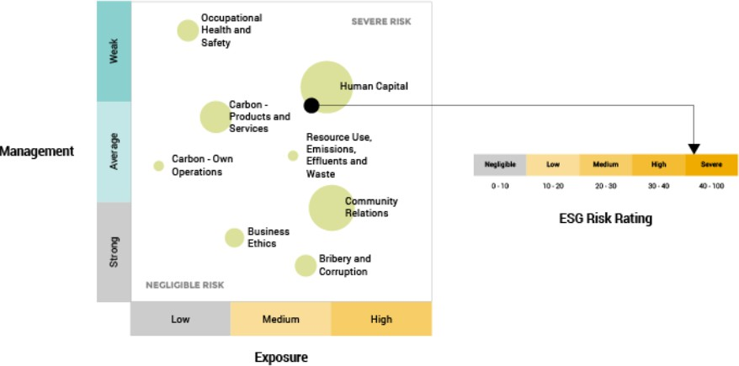
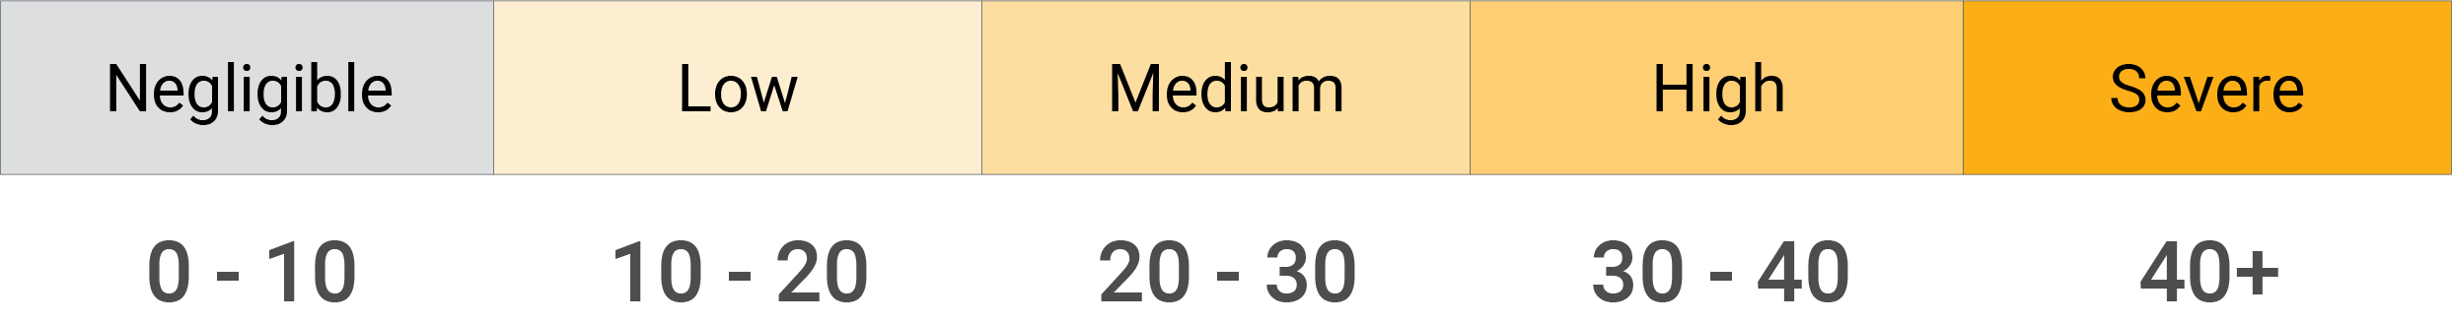
Esg Ratings
A rating of 0 indicates that a company has no unmanaged ESG risks. Conversely, a rating of 100 indicates the highest possible risk level. Due to the procedure used to determine the Sustainalytics rating, it is comparable across all industries. One problem arises when a company has a low ESG rating due to a low exposure to ESG issues, even if it has weak risk management (Sustainalytics, 2018). Figure 2 shows Sustainalytics’ approach to risk assessment.
Figure 2: Risk assessment of Sustainalytics (Sustainalytics, 2020)

Slide 30
2.3: Green Finance
Modern economic system has led to a global environmental crisis (IPCC, 2020).
Financial institutions and markets are offering 'green' financial products to address environmental concerns.
Market actors focusing on risk-return trade-off collaborate with NGOs, public entities, and civil society to combat climate change.
No universally accepted definition of green finance exists; definitions vary in scope, transparency, and origin (Migliorelli & Dessertine, 2020).

Slide 31
2.3.1: Key Events Influencing Green Finance
Rio Summit in 1992 laid foundations for global climate change discussions, leading to Agenda 21 and the UNFCCC (Rhodes, 2016).
Kyoto Protocol in 1997 was the first compulsory obligation to address climate change.
Paris Agreement in 2015 aimed to keep global temperature rise below 2°C compared to pre-industrial levels (Pires, 2017).
COP 21 marked a shift in green finance, emphasizing financing approaches to achieve climate goals.
The Millennium Summit resulted in Millennium Development Goals (MDG) to support poverty reduction and standard of living improvements (Sachs & McArthur, 2005).
MDG achievements led to the formulation of the 2030 Agenda for Sustainable Development, comprising 17 Sustainable Development Goals (SDGs) (Colglazier, 2015).
Nine out of 17 SDGs are linked to environmental protection, highlighting the role of green finance in achieving these goals (Migliorelli & Dessertine, 2020).

Slide 32
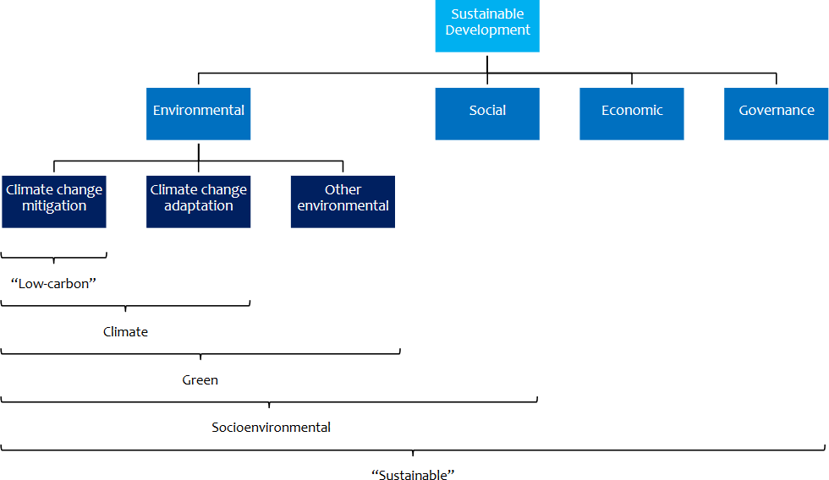
2.3.2: Connections and Key Offerings in Green Finance
Green finance, climate finance, and sustainable finance are interrelated but distinct concepts (UNEP Inquiry, 2016).
Climate finance focuses on climate change mitigation and adaptation, often linked with the UNFCCC.
Green finance is a subset of sustainable finance, targeting environment-related SDGs (G20 Green Finance Study Group, 2016; Kahlenborn et al., 2017).
Sustainable finance integrates all ESG dimensions and aims to fulfill all SDGs.
Figure 4: Related concepts of green finance (UNEP Inquiry, 2016)

Slide 33
Green finance provides a variety of products and services.
Green bonds: Green bonds are fixed income products supporting environmental and climate goals, foundational to green finance and including climate bonds focused on climate change projects.
Green asset backed securities (Solar): Green ABS are instruments backed by pools of sustainable assets. have emerged as a significant part of the green finance market, accounting for approximately 17% of the market.
Green loans: Green loans were introduced to meet demand for smaller environmental investments, governed by Loan Market Association's green loan principles, similar to green bond principles (Meager, 2017).
Green funds: they integrate environmental approaches into investment strategies, offering investors the chance to support environmentally friendly companies through debt or equity investments.
Green project financing operations: Green project financing involves banks, equity investors, and lenders primarily for renewable energy projects, with classification based on use of proceeds and sponsorship decision.
Green indices: It provide focused information on specific sectors like renewable energy in the green finance market, with providers steadily increasing

Slide 34
2.3.3: Challenges in Green Finance
The future of green finance hinges on clear definitions and commitments from policymakers and industries (Boracheva & Smorodinov, 2017).
Challenges include defining 'green', encouraging green security issuance, and proving direct financial benefits of green securities.
Green finance needs to transition from niche to mainstream financing for significant environmental impact (Berensmann & Lindenberg, 2019).
Policymakers must enact structured policies to promote green securities and integrate environmental risks in financial decisions.
International political commitment to climate change and environmental targets impacts green finance success (Migliorelli & Dessertine, 2020).
Challenges specific to green bonds include lack of ratings, indices, domestic investors, guidelines, and awareness of international practices (Kahlenborn et al., 2017).

Slide 35
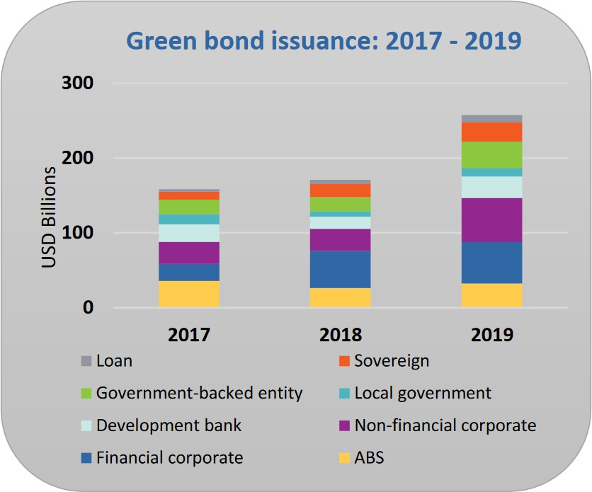
2.4: Green Bonds
European Investment Bank (EIB) launched the first green bond, the Climate Awareness Bond, in 2007, followed by the World Bank in 2008 (Migliorelli & Dessertine, 2020).
Initially, issuers were multilateral development banks (MDBs) and sovereign supranational agencies (SSAs).
Green bond market expanded to include corporations, governments, and banks after the green bond principles were introduced.
In 2019, global green bond and green loan issuance reached USD $257.7 billion, a 51% increase from 2018 (Ketterer et al., 2019).
Global green bond and green loan issuance reached a record USD $257.7 billion in 2019, with a 51% increase from the previous year (CBI, 2020).
Figure 5: Global green bond market growth 2017-2019 (CBI, 2020)

Slide 36
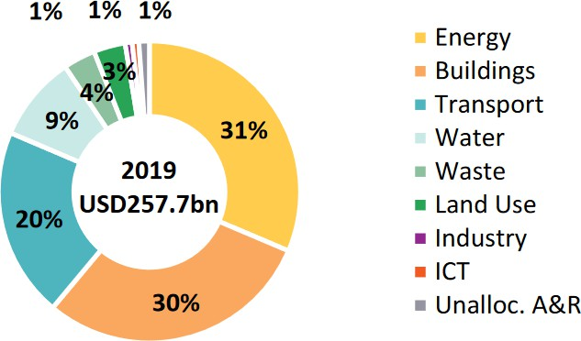
Despite rapid growth, green bonds still represent less than 1% of the global bond market.
European market drives the most volume, accounting for 45% of global issuance, followed by Asia-Pacific (25%) and North America (23%).
Top green bond issuers in 2019 were the US, China, and France, together accounting for 44% of the market.
Renewable energy, low-carbon buildings, and energy efficiency are the most common use sectors for green bond proceeds, each with around 30% market share.
ICT sector emerged in 2019 as a new area for green bond investment (Ketterer et al., 2019).
Figure 6: Use of green proceeds in 2019 (CBI, 2020)

Slide 37
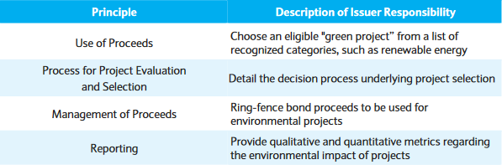
2.5: Defining “green” in green bond
The determination of the ‘greenness’ of the bond is an interesting topic, but it is beyond the scope of this.
Green bond labels are determined by issuers without a uniform definition.
The Green Bond Principles (GBP) by the International Capital Market Association (ICMA) are the most established guidelines, focusing on four key aspects: use of proceeds, project evaluation, management, and reporting (Preclaw & Bakshi, 2015).
Adherence to GBP is voluntary, leading to calls for binding standards to ensure market integrity and growth (Krimphoff & et al., 2016).
Other frameworks include the Nordic Investment Bank's eligibility categories and those from the Asia Development Bank (ADB) and International Finance Corporation (IFC) (Kahlenborn et al., 2017).
European Investment Bank (EIB) aims to improve green bond guidelines through a descriptive taxonomy, partnering with China Green Finance Committee (CGFC), People’s Bank of China (PBoC), Institute for Climate Economics (I4CE), and World Wildlife Fund (WWF) (Kahlenborn et al., 2017).
Figure 7: Overview of the GBP (Preclaw & Bakshi, 2015)

Slide 38
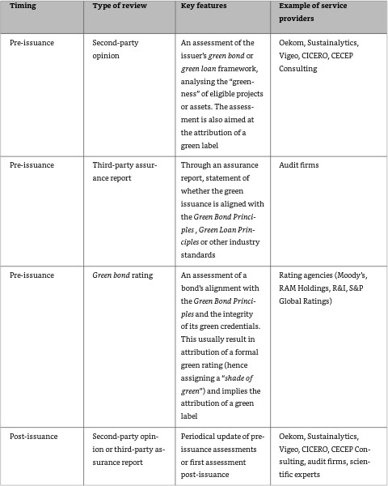
2.6: Reviews from Outside Sources and Associated Costs
External reviews verify environmental project performance in green bonds, with about 60% of green bonds certified by external parties (Boulle et al., 2016).
Types of reviews include second-party opinion, third-party assurance report, and green bond rating, either pre- or post-issuance.
Table 2: Most common types of external review (Migliorelli & Dessertine, 2020)

Slide 39
S&P offers green bond ratings from GB5 (poor) to GB1 (excellent), emphasizing alignment with the Green Bond Principles (Migliorelli & Dessertine, 2020).
Green bond issuance involves transaction costs like reporting, certification, and monitoring, varying by bond type, market, size, issuer, and frequency.
Certification costs range from USD $15,000 to $20,000 for GBP alignment and 0.1 bps for CBI certification (Ketterer et al., 2019).
OECD reports second-party verification costs between USD $10,000 to $100,000 (OECD, 2016).
Ceci estimated external costs for a USD $500 million green bond at 0.3 to 0.6 bps (Ceci, 2016).
High external review costs and project shifts to eco-friendly initiatives create barriers for companies entering the green bond market (Zerbib, 2018).

Slide 40
2.7: Risk associated with green washing
'Greenwashing' is a deceptive marketing strategy where companies overstate their environmental responsibility (Migliorelli & Dessertine, 2020).
Incentives for greenwashing include enhanced reputation and attracting environmentally conscious customers willing to pay more (Baum, 2012).
Green bond issuers self-label their bonds as green without penalties for false claims, exposing investors to risks of greenwashing (Hachenberg & Schiereck, 2018).
Lack of a uniform definition for 'green' exacerbates the risk of greenwashing.
Joshua Kendall found that 15% of analyzed green bonds failed to meet minimum ESG, impact, and framework criteria (Robinson, 2019).
Greenwashing is tempting for firms due to the absence of moral obligations or pressure.

Slide 41
Theoretical Framework
Chapter 3

Slide 42
3.1 Bonds
A bond is a fixed income obligation to repay the loan and interest (Berk & DeMarzo, 2020).
Bonds allow transfer and trading in primary and secondary markets (Gantenbein & Spremann, 2014).
Main issuers: corporations, financial firms, supranational institutions, and government-related groups (ONB, 2020).
Fixed-rate bonds offer a set interest rate and full repayment; can be unsecured or secured (ONB, 2020).
Eurobonds are issued in a currency different from the country (Gantenbein & Spremann, 2014).
Maturities vary: <3 years is short-dated, >10 years is long-dated (Gantenbein & Spremann, 2014).

Slide 43
3.1.1 Bond Valuation
Bond valuation determines market price based on discounted cash flows and issuer's IRR (Damodaran, 2012).
Equations:
* C = rc * F
* 𝑃𝑉 = ∑(t=1 to n) 𝐶 /(1 +𝑟)𝑡 𝑡=1 + 𝐹 /( 1+𝑟)n combines discounted coupon payments and face value.
Face value: typically, €1,000 (Pimco, 2017).
Coupon rate: fixed annual interest.
YTM influences PV and correlates with market rates (Damodaran, 2012).

Slide 44
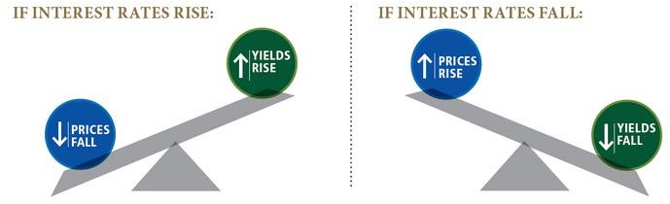
3.1.2 Effect of Interest Rates on Bond Prices and Yields
Bond prices move inversely to market interest rates due to interest rate risk (SEC, 2020).
Falling interest rates:
- Bond prices rise.
- YTM falls.
Rising interest rates:
- Bond prices fall.
- Older bonds may sell at a discount (Pimco, 2017).
Bond cash flows:
- Coupon payments.
- Difference between present value and par value
Figure 8: The effect of interest rates on bond prices (Pimco, 2017)

Slide 45
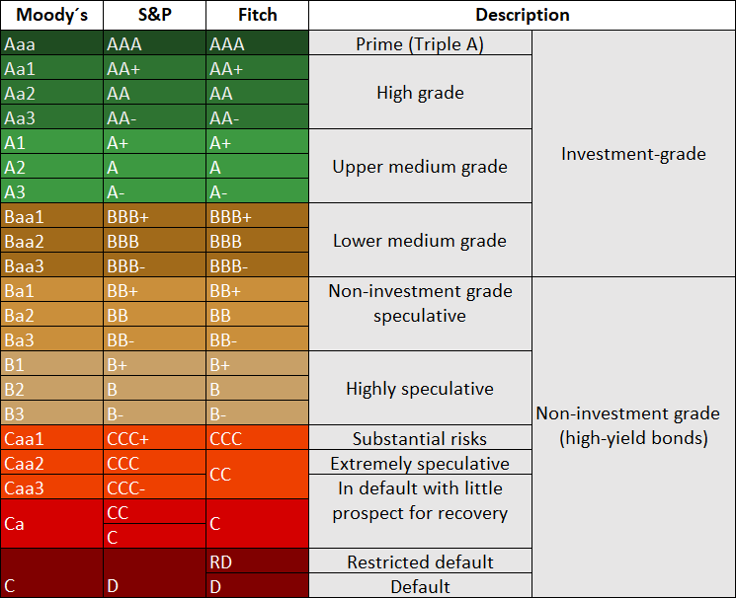
3.2 Bond Credit Rating
Bond credit ratings indicate probability of default.
Issued by major agencies: Moody’s, S&P, Fitch.
Ratings range from AAA (highest creditworthiness) to D (lowest).
AAA-rated bonds are risk-free benchmarks.
Lower ratings imply higher default risk and borrowing costs.
AAA to BBB-: Investment grade; preferred by banks, pension funds.
Below BBB-: Non-investment grade, high-yield, or junk bonds.
Lower ratings can hinder company refinancing.
Some companies are unrated due to high rating costs.
Green bonds generally have higher credit ratings.
Table 3: Bond credit rating based on Moody’s, S&P and Fitch Ratings

Slide 46
3.4 Risk Premiums
Risk premiums compensate investors for additional bond risks.
Premiums often expressed as spreads.
Systematic Risk:
Includes market interest rates.
Maturity premium tied to bond duration.
Liquidity impacts bond risk.
Illiquid bonds have higher premiums.
Unsystematic Risk:
Systematic Risk: Market-driven, includes interest rate and liquidity risks.
Unsystematic Risk: Firm-specific, notably default risk.
Mitigated by diversification.
Investigation Focus:
Investigating negative green bond premium.
Implies investors pay issuer for green label.
Results in lower spreads than non-green bonds.

Slide 47
Literature Review
Chapter 4

Slide 48
4.1: Previous Studies
Focus on existing studies on green bonds.
Limited number of investigations due to novelty.
Contributions to empirical research on green bonds.
Studies conducted by financial organizations, companies, and academics.
Section 4.1: Presentation of key previous studies.
Section 4.2: Overview of SRI-related studies and ESG rating.
Eight most important studies on green bond premium.
Chronological listing of studies.
Examination of sample size, procedure, and findings.
Table 4: Summary of research methods and empirical findings.

Slide 49
Preclaw and Bakshi:
Preclaw and Bakshi's study compared performance of green bonds to conventional bonds using OLS regression from March 2014 to August 2015 in the secondary market.
Found a green bond premium of -17 bps, attributing it to high demand from environmentally focused funds, oversubscription, and investor preference for non-financial gains.
HSBC:
HSBC's research compared premia between green and conventional bonds using a sample of 30 primary market and four secondary market green bonds from November 2015 to September 2016.
Found no significant yield differences between green and non-green bonds.
Bloomberg:
Bloomberg's study analyzed 12 green bonds from government-related issuers from March 2014 to December 2016, using the matching pair method.
Found a green bond premium of -25 bps for Euro-denominated government-related bonds, while no significant yield difference was observed for USD-denominated green corporate bonds.

Slide 50
Ehlers and Packer:
The study analyzed 21 green bonds from 2014 to 2017 using the matching pair method, covering both government-related and corporate bonds.
Found an average green bond premium of -18 bps, attributing the difference to high demand relative to supply and noting increased yield differences for riskier borrowers.
Karpf and Mandel:
Karpf and Mandel analyzed 1,880 green bonds from 2010 to 2016 against 36,000 conventional bonds, using the Oaxaca–Blinder decomposition for yield curve comparison.
Found a statistically significant positive spread of 7.8 bps between green and conventional bonds, attributed to the creditworthiness and financial stability of green bond issuers, with a shift from positive to negative premium due to unclear factors like reputation or demand.
Zerbib:
Zerbib analyzed 110 green bonds from July 2013 to December 2017 using a matching method and two-step regression procedure to estimate a significant average green bond premium of -2 bps, with negative premia persisting from May 2016 onwards.
Identified issuer type and bond rating as significant factors affecting the premium, attributing the negative premium to high buying pressure, limited supply, excess demand, and large issuance volumes.

Slide 51
Hachenberg and Schiereck:
Hachenberg and Schiereck compared 63 green bonds with 126 non-green bonds from October 2015 to March 2016, finding no statistical difference in pricing between green and conventional bonds except for A-rated green bonds, which traded 3.88 bps tighter.
Detailed analysis revealed government-related green bonds traded wider, while financial green bonds traded tighter; ESG ratings significantly impacted pricing, and the study also highlighted higher issuance costs for green bonds due to additional certification and opinion expenses.
Bachelet, Becchetti and Manfredonia:
Bachelet, Becchetti, and Manfredonia's 2019 study of 89 green bonds from 2013 to 2017 found a positive green bond premium ranging from 2.06 to 5.9 bps compared to brown bonds.
The study differentiated between institutional and private issuers, revealing a negative premium for institutional green bonds and a positive one for private green bonds, emphasizing the role of liquidity in yield differences.

Slide 52
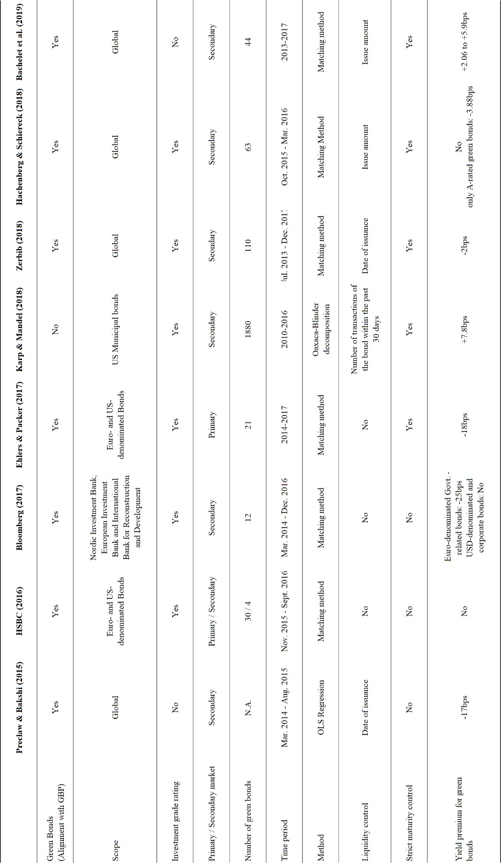

Slide 53
4.2 Related Studies
ESG Impact on Corporate Performance:
Friede, Busch, and Bassen (2015): positive ESG impacts on bond performance exceeding equity market studies
CSR and Bond Ratings/Spreads:
Goss and Roberts (2011): companies with poor CSR pay 7-18 bps more for bank loans
SRI Bond Funds vs. Conventional Funds:
Derwall et al. (2005): found SRI bond funds similar to conventional ones, but SRI balanced funds outperformed by 1.3%.
Liquidity and Green Bonds:
Wulandari et al. (2018): observed decreasing impact of illiquidity on green bond yield spreads over time, noting recent liquidity risk as negligible.

Slide 54
Data & Methodology
Chapter 5

Slide 55
5.1: Data
Data Collection and Source:
Data from Bloomberg's green bond database.
Bloomberg's high standards ensure reliable and high-quality data.
Sample Selection:
Initial sample: 2,011 green bonds (April 22, 2020).
Focus on European green bond issuers reduce to 302 bonds.
Criteria: Fixed-rate bonds, Euros, no structured options.
Liquidity and New Issue Premium:
Liquidity measured by issue amount (>€500 million).
Pricing date set to on/before October 25, 2019.
Final sample: 142 green bonds.
Benchmark and Pricing Source:
Risk-free benchmark: Government securities.
Bloomberg Valuation Service (BVAL) chosen as pricing source.

Slide 56
Matching and Comparable Bonds:
Matched pairs approach used to counteract heterogeneity.
Criteria for comparable bonds: issuer, ranking, currency, structure, size.
Final sample: 37 green bonds and 72 non-green bonds.
Data Timeframe and Frequency:
i-spreads observed from November 1, 2019, to April 30, 2020.
125 daily i-spreads per bond extracted.
ESG Ratings and Issuer Analysis:
ESG ratings from RobecoSAM or Sustainalytics.
Sample: 21 issuers with ESG ratings.
Rating categories: AAA, AA, A, BBB.
Descriptive Statistics:
Average rating: 5.32 (A+/A1).
Average remaining maturity: 4.5 years.
Over half of issuers have ESG ratings.
- Non-green bonds show higher mean issue amounts.

Slide 57
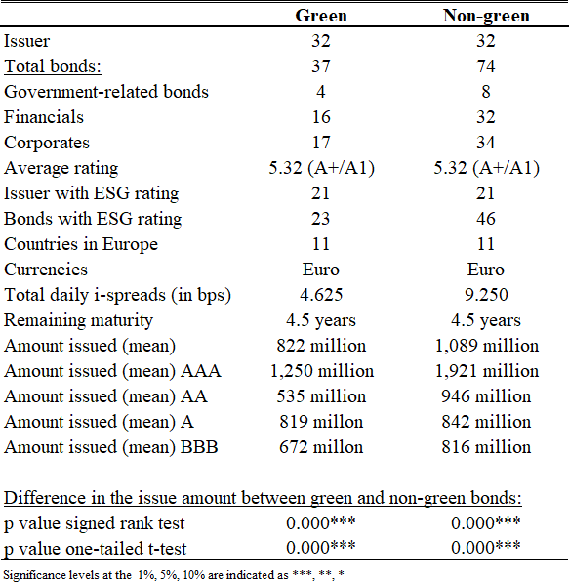
Descriptive statistic of the bond sample

Slide 58
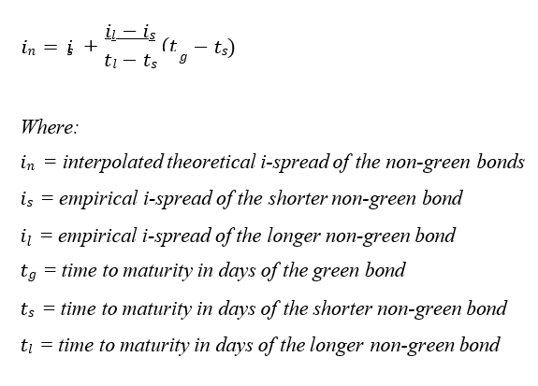
5.2: Methodology
Utilized Isaac Newton’s formula for linear interpolation based on Hachenberg and Schiereck's study.
Equation 3: Linear interpolation

Slide 59
5.2.2: Tests of Statistical Hypotheses and Correlation Analysis
Hypothesis Testing Methods for the First Hypothesis:
Utilized the Wilcoxon signed-rank test and one-tailed t-test due to uncertainty in sample normality, with Pearson correlation for examining linear correlation between green and non-green bond i-spreads.
Analysis for Hypotheses 2 and 3:
Employed Analysis of Variance (ANOVA) using the F-test to compare mean values between groups, and Bonferroni multiple comparison test for post hoc analysis to determine i-spread differences within rating groups and industries.

Slide 60
5.2.3: Analysis of Panel Data
Panel Data Analysis:
Employs panel data, combining time series and cross-sectional dimensions for a more comprehensive analysis.
Advantages include increased degrees of freedom, reduced collinearity, and better accuracy in forecasting; disadvantages involve unobserved heterogeneity.
Random Effects Model:
Utilized to mitigate unobserved effects, allowing for high comparability with previous studies.
Panel regression is clustered by International Securities Identification Numbers (ISINs) and robust standard errors are applied for each model.

Slide 61
Empirical Results
Chapter 6

Slide 62
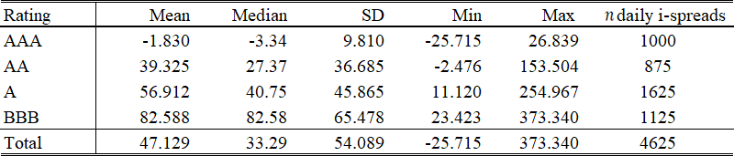
6.1: Descriptive Statistics of the Daily I-spreads
Descriptive Statistics of i-spreads:
Data collected from November 1, 2019, to April 30, 2020.
Mean daily i-spreads of green bonds increase with lower ratings due to rising default risk premium.
AAA-rated bonds show a negative i-spread (-1.83 bps) attributed to negative interest rates.
Table 8: Summary of the daily i-spreads of green bonds

Slide 63
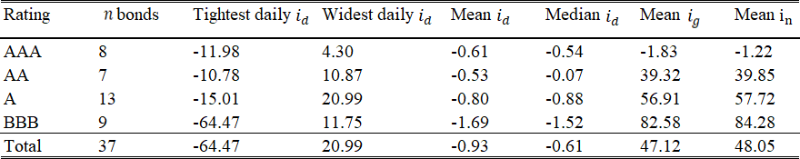
Green Bond Premium Analysis:
Negative green bond premium observed across all rating classes.
BBB-rated bonds have the highest negative premium (1.69 bps), followed by A-rated (0.80 bps), and AA-rated (0.53 bps).
Unexpectedly, AAA-rated green bonds show a greater negative premium (-0.61 bps) than A-rated bonds.
Overall negative green bond premium is marginal at 0.93 bps.
Table 9: Summary of the daily i-spread deltas of green and non-green bonds

Slide 64
Market Trends and Impacts:
Figures 9-12 show close alignment of green and non-green bond i-spread movements.
Sharp rise in i-spreads observed from March due to the global coronavirus pandemic.
Increased trading activity, higher default risk, and liquidity needs contributed to rising i-spreads.
BBB-rated bonds most affected, with an increase of nearly 150 bps (1.50% yield) due to concerns of possible downgrade and corporate bond vulnerabilities.

Slide 65
Green vs. non-green bonds with AAA ratings
AAA
15
10
5
0
-5
-10
01.11.2019
16.12.2019
31.01.2020
16.03.2020
30.04.2020
green
non-green

Slide 66
Green vs. non-green bonds with AA ratings
AA
140
120
100
80
60
40
20
0
01.11.2019
16.12.2019
31.01.2020
16.03.2020
30.04.2020
green
non-green

Slide 67
Green vs. non-green bonds with A ratings
A
160
140
120
100
80
60
40
20
0
01.11.2019
16.12.2019
31.01.2020
16.03.2020
30.04.2020
green
non-green

Slide 68
Green vs. non-green bonds with BBB ratings
BBB
250
200
150
100
50
0
01.11.2019
16.12.2019
31.01.2020
16.03.2020
30.04.2020
green
non-green

Slide 69
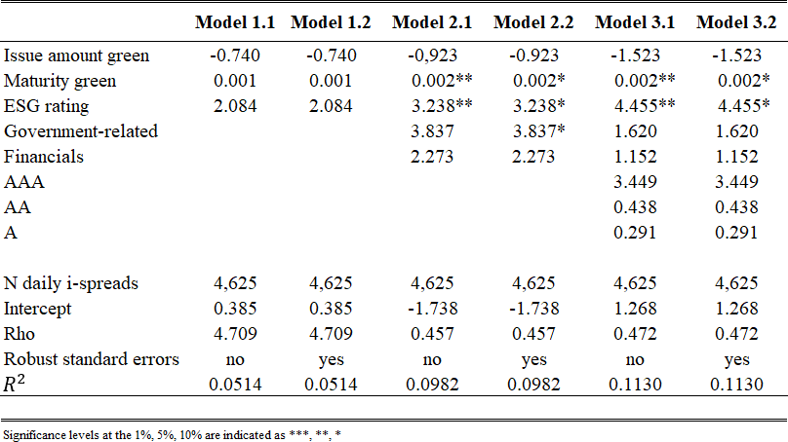
6.2: Findings from the Panel Regression Analysis
Panel Regression Results for Green Bonds:
Initial models (1.1 and 1.2) with 'Issue amount green', 'Maturity green', and 'ESG rating' are not significant (R^2 = 5.14%).
Addition of 'Government-related', 'Industry', 'Financials' variables shows significance and raises R^2 to 11.30%.
'Maturity green' coefficient: +0.002 bps/day, indicating decreasing or negative green bond premium over time.
'ESG rating' coefficient: One-time increase of +4.455 bps.
Overall, issue amount, rating, and industry of green bonds are not significant.
Panel regression and random effects model for green bonds

Slide 70
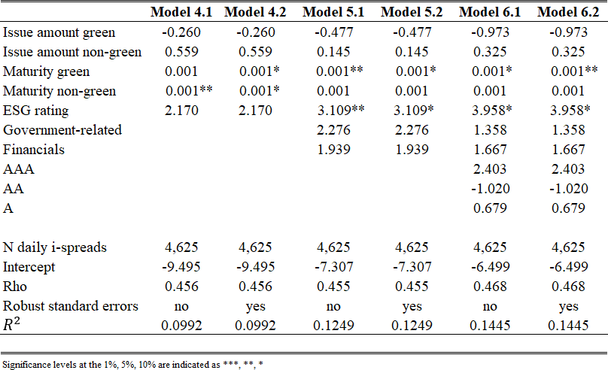
Enhanced Panel Regression with Non-Green Bonds:
Addition of 'Issue amount non-green' and 'Maturity non-green' improves model.
'Maturity non-green' is a significant driver, raising R^2 to 14.45% in Model 6.2.
'Maturity green' coefficient: Significant at a high level, reduced to +0.001 bps/day.
'ESG rating' coefficient: One-time increase of +3.958 bps.
Inclusion of non-green bond variables substantially enhances model quality.
Panel regression and random effects model for green and non-green bonds

Slide 71
Comparison with Previous Study (Hachenberg & Schiereck, 2018):
Their model found 'ESG rating' and 'Government-related' as significant (5% level) with positive coefficients.
No significant negative green bond premium observed.
'Maturity green' and 'ESG rating' are key factors explaining i-spread differential.
Related Findings from Other Studies:
ESG rating's positive impact on corporate performance and risk of default (Friede et al., 2015).
Good ESG ratings rewarded with tighter spreads and cheaper refinancing (Polbennikov et al., 2016).
High ESG score investors accept lower returns due to ESG preference (Pedersen et al., 2019).
Positive 'Maturity green' coefficient possibly explained by liquidity preference theory, suggesting increased negative green bond premium with interest rate risk.

Slide 72
6.5: Research Limitations
Scope Limitations:
Focus only on straight bonds with no options from European institutions.
Difficulty generalizing negative green bond premium to entire green bond market.
Liquidity Bias:
Bonds with issuance greater than €500 million included to ensure high liquidity.
Liquidity can change over time due to trading frequency, supply, demand, etc.
Comparison: Previous study used €150 million as the threshold.
Sample Size and Criteria:
Smaller sample size due to stringent selection criteria.
All 2,011 outstanding green bonds considered.
Possible underrepresentation of government-related issuers (only four green bonds), potentially affecting results for Hypothesis 3.

Slide 73
Market Volatility:
Bond market movement in last two months due to coronavirus pandemic.
Strong positive correlation between daily i-spreads of green and non-green bonds minimizes influence on results.
ESG Rating Limitations:
Only two ESG rating agencies (Sustainalytics and RobeccoSAM) considered.
Some issuers might have ESG ratings from other agencies, potentially skewing results.
Analysis Methodology:
Panel regression and random effects model used.
Future research can employ both random and fixed effects models and conduct Hausman test for suitability.
Suggestions for Future Research:
Include specific firm variables like liquidity coverage ratio, leverage, etc.
Consider other bond types: zero bonds, floating rate bonds, convertible bonds.
Focus on social impact bonds and climate bonds to enrich bond literature.

Slide 74
conclusion
Chapter 7

Slide 75
Importance of Green Bonds:
Contribute to sustainable projects aligned with the Paris Agreement.
Significant for investors, issuers, policymakers, and global sustainability efforts.
Research Context and Contribution:
Limited prior research due to green bonds' 12-year history.
Addresses existing literature with updated data, focusing on European issuers.
Methodology and Findings:
Sample of 37 green bonds and 74 non-green bonds analyzed.
Average negative green bond premium of 0.92 bps identified in European secondary market.
Factors explaining the premium include excess demand, investor preferences, and external costs.

Slide 76
Rating and Industry Variations:
Only BBB-rated green bonds showed significantly greater negative premium.
Evidence suggests variation across industries, especially outside government-related and financial sectors.
Influencing Factors on Premium:
Rating, issue amount, and industry found to have no significant impact.
Premium mainly influenced by remaining maturity and ESG rating of the issuer.
Maturity may relate to liquidity preference theory; ESG rating may indicate investor trust in company performance.
Implications and Future Directions:
Negative green bond premium incentivizes issuance due to refinancing advantages.
Supports policymakers in promoting sustainable development.
Investor interest remains high despite lower yield performance of green bonds.
Increase in green bond issuance could contribute to achieving Paris Agreement goals and addressing environmental degradation.

Slide 77
Critic for the study
Scope of Research: The research focuses on the green bond market, specifically in Europe, and its implications for investors, issuers, and policymakers.
Data Collection: The data collection period from November 1, 2019, to April 30, 2020, is relatively short.
Negative Green Bond Premium: The study concludes that there is an average negative green bond premium of 0.92 bps in the secondary European market.
Rating and Issue Amount: The study finds that neither rating nor issue amount significantly influences the negative green bond premium.
ESG Rating: The study finds a correlation between the ESG rating of the issuer and the negative green bond premium.
Future Implications: The study concludes on a hopeful note about the potential of green bonds to contribute to the goals of the Paris Agreement.

Slide 78

Thank you!!

